Slide 1

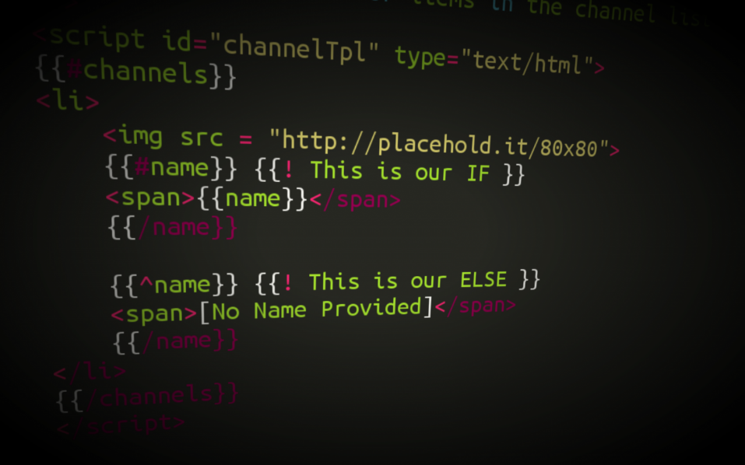



Templating, Routing, lodash
Extending functionality
using Collections
SoftUni Team
Technical Trainers
Software University
http://softuni.bg

Slide 2


Table of Contents
What is Sammy.js?
Create custom URLs
Using HTML templates with Mustache.js
Extend JavaScript functionality using lodash.js
What extensions does it offer?
Collection extensions
Array extensions
Function extensions
Object extensions

Slide 3

Application routing
Defining URL structure of app

Slide 4

What is Sammy.js?
JavaScript framework providing:
Routes – defining the basic structure of RESTful your application
Events – creating custom events implementing some logic
Well suited for building simple RESTful applications
Using JSON data stores

Slide 5

Installing sammy.js
Download sammy.js from http://sammyjs.org/download
Include it in your project
Place sammy.js after jQuery
Create routes for your application

Slide 6

Application routing
Live Demo

Slide 7

HTML Templating
Fill HTML templates with data

Slide 8

What is Mustache.js?
Logic-less templates:
Used for HTML, config files, source code – anything
Logic-less – does not contain if-else statements or loops.
Entirely defined by tags.
Runs on many languages like: Ruby, Python, JavaScript, PHP, Perl etc.

Slide 9
Installing mustache.js
Download mustache.js from https://github.com/janl/mustache.js
Include it in your project
Place mustache.js after jQuery
Create templates for your application

Slide 10

HTML Templating
Live Demo

Slide 11

Lodash.js
Extending JavaScript functionality

Slide 12
lodash.js
Lodash.js is a JavaScript library, that extends regular JavaScript functionality
Provides extensions to object, arrays, selection, etc..
Usable is client JavaScript (web and mobile) and server JavaScript (Node.js)

Slide 13
lodash.js Functionality
Lodash extends the functionality for:
Collections
each, map, find, filter, where, some, countBy
Arrays
first, last, union, uniq, range
Functions
bind, delay, defer, once, after
Objects
keys, values, extend, functions, clone
Templates and Chaining

Slide 14
Extensions for Collections

Slide 15
Collections
Collections == arrays and objects
All underscore methods work both on arrays and objects (associative arrays)
Collection extensions:
_.each() - iterates over a collection
_.map(), _.pluck() - a projection of a collection
_.filter(), _.reject() and _.where - filter elements
_.all() and _.any() - evaluate a collection
_.sortBy(), _.groupBy() - sorts and groups

Slide 16
Collections: each()
_.each() iterates over a list of elements, yielding each in turn to an iterator function
Similar to for-in loop
Uses the native forEach() function if the browser supports it
var numbers = [1, 2, 3, 4, 5, 6, 7, 8];
_.each(numbers, console.log);
_.each(numbers, function(item) { console.log(item); }
//log all the numbers

Slide 17
_.each()
Live Demo

Slide 18
Collections: map()
_.map() produces a new array of elements, after the values are computed
Uses the native map() function if the browser supports it
Can be used with objects as well:
var numbers = [0, 1, 2, 3, 4, 5, 6, 7, 8];
var numberNames = ["zero", "one", "two", "three"];
function numbersToNames(item) { return numberNames[item]; }
_.map(numbers, numbersToNames);
_.map(console, function (item) {
return item.toString();
});

Slide 19
_.map()
Live Demo

Slide 20
Collections: filter() and reject()
Filter and reject return a subset of the original collection, based on an boolean expression
Filter returns all items matching the condition
Reject returns all items that do not fulfill the condition
var numbers = [0, 1, 2, 3, 4, 5, 6, 7, 8];
var even = _.filter(numbers, isEven);
var odd = _.reject(numbers, isEven);
function isEven(number) {
return number % 2 === 0;
}

Slide 21
_.filter() and _.reject()
Live Demo

Slide 22
Collections: where()
_.where() filters a collection based on a property value
Returns a subcollection of the original collection
var people = [{name: "Ivan Todorov", age: 21},
{name: "Todor Ivanov", age: 11},
{name: "Petra Georgieva", age: 14},
{name: "Georgi Petrov", age: 11},
{name: "Stamina Staminova", age: 19}];
var elevenYearsOld = _.where(people, {age: 11});
// returns Todor Ivanov and Georgi Petrov

Slide 23
_.where()
Live Demo

Slide 24
Collections: all() and any()
_.all() returns true if ALL of the elements that meet a boolean expression
_.any() returns true if ANY of the elements fulfill a boolean condition
And false if none if the elements fulfill the condition
var numbers = [1, 2, 3, 4, 5, 6, 7, 8, 9, 10];
var anyEven = _.any(numbers, function(el){ return el % 2 == 0; });
//anyEven = true
var allEven = _.all(numbers, function(el){ return el % 2 == 0; });
//allEven = false;

Slide 25
_.all() and _.any()
Live Demo

Slide 26
Collections: pluck()
_.pluck() returns a projection of a collection
Returns only a part from all elements
var people = [
{username: "VGeorgiev", email: "vlado@softuni.bg"},
{username : "Teodor92", email: "kurtev@softuni.bg"},
{username : "nakov", email: "spam@nakov.com"},
{username : "Petya", email: "petya@softuni.bg"}];
var emails = _.pluck(people, 'email');
// emails = ["vlado@softuni.bg", "kurtev@softuni.bg", "spam@nakov.com", "petya@softuni.bg"]

Slide 27
_.pluck()
Live Demo

Slide 28
Collections: sortBy()
_.sortBy() sorts the elements of a collection
Much like the native sort() function
Sorts by a property or an iterator function
var students = [
{fname: "Mitko", lname: "Ruletkata", age: 63},
{fname: "Gencho", lname: "Ganev", age: 32},
{fname: "Penio", lname: "Penev", age: 10},
{fname: "Unufri", lname: "Unufriev", age: 17}];
var sortedByLastname = _.sortBy(students, "lname");
var sortedByAge = _.sortBy(students, "age");

Slide 29
Collections: groupBy()
_.groupBy() groups the elements of a collection
Groups by a property or an iterator function
var cars = [
{make: "Nissan", model: "Skyline", color: "red"},
{make: "Audi", model: "A6", color: "blue"},
{make: "Lada", model: "Vesta", color: "red"},
{make: "Moskvich", model: "412", color: "yellow"},
{make: "Peugeot", model: "206", color: "red"}];
var carsByColor = _.groupBy(cars, "color");

Slide 30
_.sortBy() and _.groupBy()
Live Demo

Slide 31
Array Extensions

Slide 32
Array Extensions
Array extensions work only on array objects
Does not work on associative arrays or objects
Array extensions:
_.first() and _.initial() selects the first n items
_.last() and _.rest() selects the last n items
_.compact() - removes all false values
_.union() and _.intersection() - unites or intersects two or more arrays

Slide 33
Arrays: first() and initial()
_.first() returns the first element in an array
Can be used with a parameter to return the first n elements
_.initial() returns all elements except the last one
Can be used with a parameter to all the elements except the last n
var numbers = [1, 2, 3, 4, 5];
var first = _.first(numbers); // 1
var firstTwo = _.first(numbers, 2); // [1, 2]
var numbers = [1, 2, 3, 4, 5];
var initial = _.initial(numbers); // [1, 2, 3, 4]
var initialTwo = _.initial(numbers, 2); // [1, 2, 3]

Slide 34
_.first() and _.initial()
Live Demo

Slide 35
Arrays: last() and rest()
_.last() returns the last element in an array
Can be used with a parameter to return the last n elements
_.rest() returns all elements except the first one
Can be used with a parameter to return everything after the first n
var numbers = [1, 2, 3, 4, 5];
var first = _.last(numbers); // 5
var firstTwo = _.last(numbers, 2); // [4, 5]
var numbers = [1, 2, 3, 4, 5];
var initial = _.rest(numbers); // [2, 3, 4, 5]
var initialTwo = _.rest(numbers, 2); // [3, 4, 5]

Slide 36
_.last() and _.rest()
Live Demo

Slide 37
Object Extensions

Slide 38
Object Extensions
Object extensions provide some additional functionality to regular objects
_.keys(obj) – list of all the keys of an object
_.values(obj) – list of the values of an object
_.invert(obj) – inverts the keys and the values
_.extend(obj, properties) – performs prototypal inheritance

Slide 39
Object Extensions
Live Demo

Slide 40









Web Storage and Cookies
https://softuni.bg/courses/javascript-applications/

Slide 41
License
This course (slides, examples, demos, videos, homework, etc.) is licensed under the "Creative Commons Attribution-NonCommercial-ShareAlike 4.0 International" license
Attribution: this work may contain portions from
"JavaScript Applications" course by Telerik Academy under CC-BY-NC-SA license

Slide 42




Free Trainings @ Software University
Software University Foundation – softuni.org
Software University – High-Quality Education, Profession and Job for Software Developers
softuni.bg
Software University @ Facebook
facebook.com/SoftwareUniversity
Software University @ YouTube
youtube.com/SoftwareUniversity
Software University Forums – forum.softuni.bg

